Slide 1
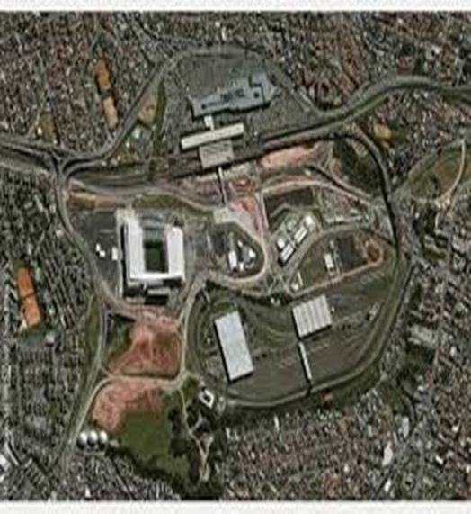

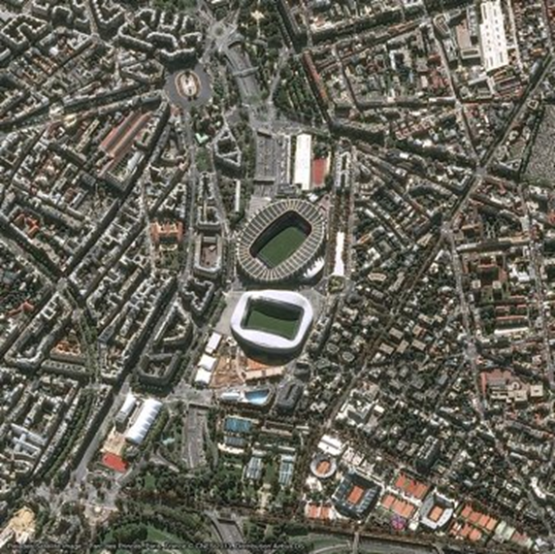


Micronet Solutions

Slide 2
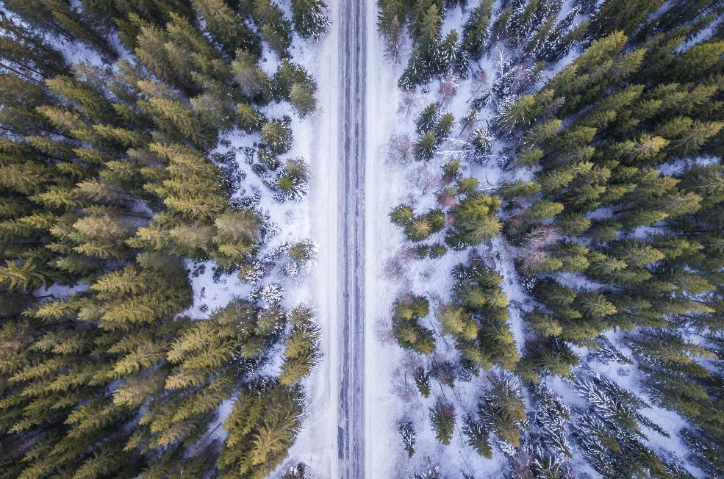
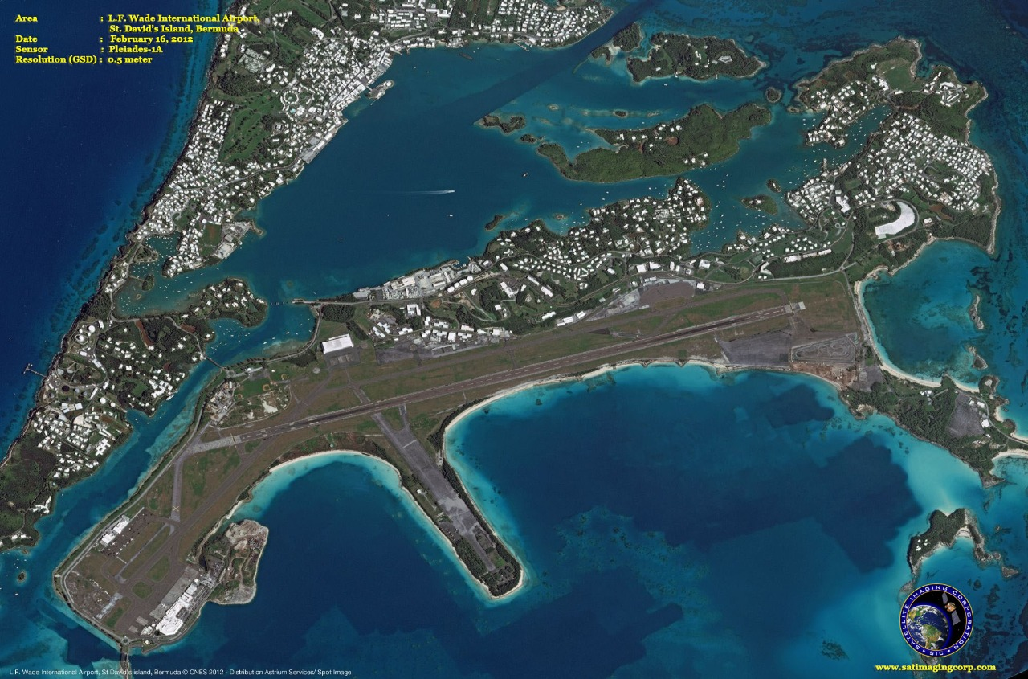
We have 15 years of experience in dealing and implementing projects for Various central & State government agencies. Micronet Solutions has line production facilities to handle large volumes of spatial data ensuring timely deliverables and quality outputs. Simplying complex problems for geo-spatial database creation and ensuring industry standard quality benchmarks are our forte.We are authorized Distributors of Airbus Defence and Space (France) for india and Planet labs marketing partner

Slide 3
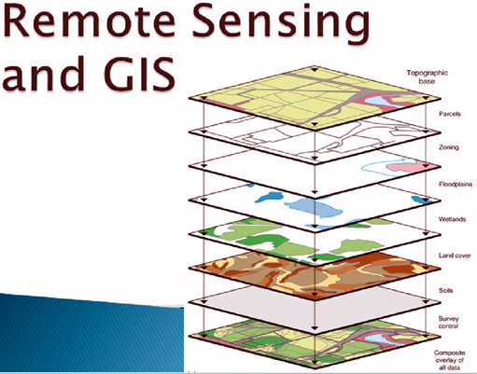

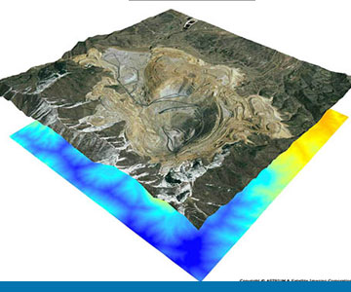
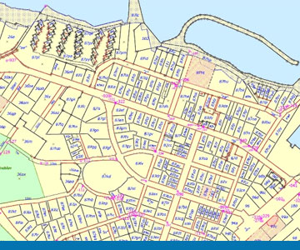
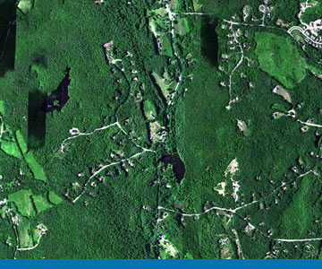

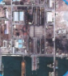

The Key solutions
Photogrammetry Services
Agriculture
Mine Monitoring Solutions
Cadastral Mapping and Urban Mapping
Crop identification & Monitoring
Crop health and Monitoring
Crop yield Estimation
Crop rotation Monitoring
Crop Damage Estimation
Field activity, Soil Moisture
Aerial Triangulation
Stereo Compilation / 3D Map production
Digital Elevation Model
Digital Surface Model
Digital Terrain Model
Digital Orthophoto
Change Detection Services
Volumetric Changes
Water Pipeline Networks, Sewage Networks, Electrical Networks,
Road Transportions
Forestry and Environment
Oil and Gas
Strategic, tactical and operations
Combat missions
Route planning
Training and simulations
Air, sea, and land navigation
Command, control, communications, and intelligence operations
Modeling and simulation
Mapping of crown density for reserve forests
Identification of potential sites for afforestation purpose
Creation of baseline information for forest and wastelands management
Detect seismic lines and well locations
Document persistent offshore oil seepage
Map rock formations, elevation, and major structures
Update coordinates of old well locations
Differentiate major rock types
Identify barren and productive basin areas
Perform noninvasive mapping to preserved areas

Slide 4

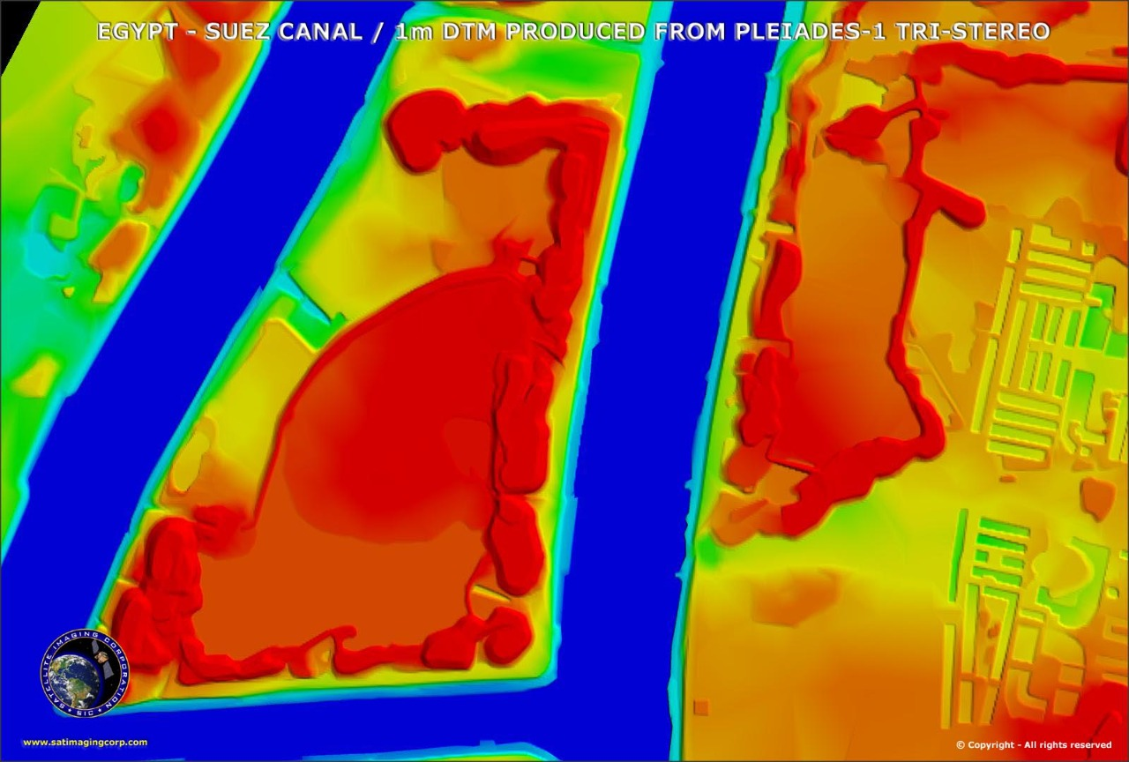
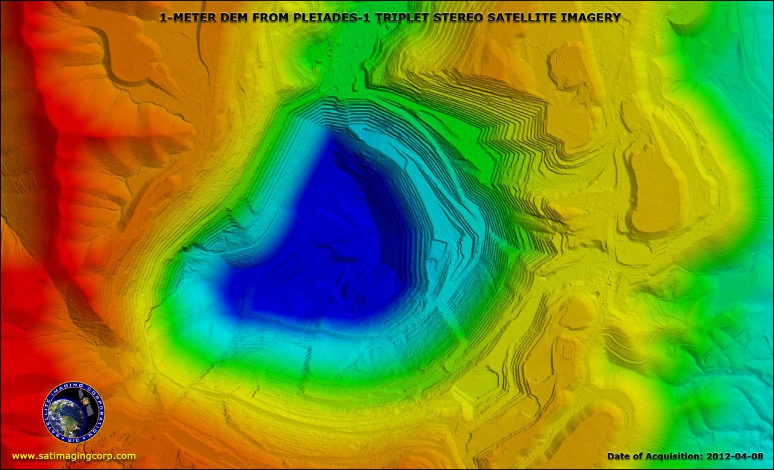
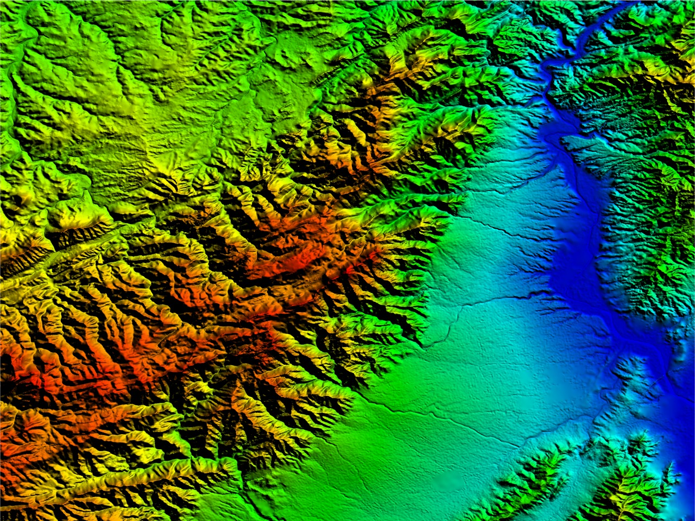
Photogrammetry Services
(1)Aerial Triangulation
Aerial triangulation is the process of establishing a mathematical relationship between the images contained in a project, the concerned camera or sensor, and the ground coordinate system. The process of AT represents the mathematical process of determining precise and accurate relationships between the individual image coordinate system and a defined datum and projection (ground). The information resulting from triangulation process is required as an input for further processes of Digital Terrain Modeling,Vector Compilation & Orthophoto rectification of images.
(2)Stereo Compilation / 3D Map production
Stereo (Photogrammetry) compilation refers to locating data, on stereo satellite images in their proper horizontal & vertical positions according to the map projection system, datum and the scale being used.
(3)Digital Elevation Model
A Digital Elevation Model (DEM) contains mass points (X, Y) which are positioned in a regularly spaced grid (for example 10m x 10m or 20m x 20m). The elevation values (Z) in a DEM represents the height of the terrain, relative to a specific vertical datum. The DEM does not contain any manmade structures such as buildings, bridges, walls etc. The DEM is kind of a raster data structure and therefore is similar to a digital image
(4)Digital Surface Model
A Digital Surface Model (DSM) is similar to a DEM containing mass points (X, Y) which are positioned in a regularly spaced grid (for example 10m x 10m or 20m x 20m). The elevation values (Z) in a DEM represents the height of the terrain, relative to a specific vertical datum. A DSM contains all features (manmade as well as natural) and it covers all buildings, vegetation, bridges etc. In other words, a DSM incorporates everything as visible from the aerial view, ground as well as elevated features.
(5)Digital Terrain Model
A digital terrain model (DTM) also consists of mass points (X, Y) with elevation values (Z) but unlike the DEM, the mass points are not in the form of a regularly spaced grid. The mass points are placed randomly as per the undulation of the terrain and the density of points can be adjusted so as to represent the actual terrain. In other words, lesser mass points can be used in a flat area more mass points can be captured to describe undulating terrain. Break lines (to depict sudden change in the terrain) are also an integral feature in a DTM, besides the mass points.
(6)Digital Ortho photo
An ortho photomosaic is a raster image made by merging ortho photos — satellite photographs which have been transformed to correct for perspective so that they appear to have been taken from vertically above at an infinite distance. An Ortho photo fulfills a fundamental role as a geometrically accurate base map.

Slide 5

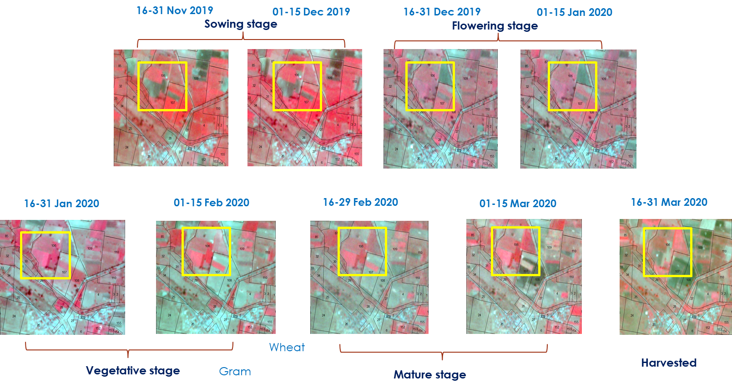
Agriculture
Micronet Solution bring the agricultural technology to the next level with the help of Remote sensing and High Resolution Imagery. We adopt the approach of AI & ML with geo-spatial technologies, combinting the internet of things (IoT) to deliver agriculture solutions and services in a quick turnaround time while maintaining the best quality standards.
Crop identification: -
The spectral reflectance of crops at each of these growth stages is called the temporal profile of the crop. This information is extracted from High Resolution satellite Data based on surveyed locations (boundaries) of dominant crop types in the area of interest.
Crop Acreage Estimation:-
Crop acreage base is a crop-specific measure equal to the average number of acres planted (or considered planted) to a particular program crop for a specified number of years.
Crop yield Perdition:-
Crop Yield Prediction is the methodology to predict the yield of the crops. Currently Micronet Solution using the Remote sensing technology can predict the crop yield a large area in limited time.

Slide 6
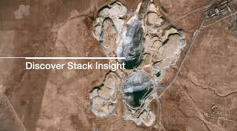
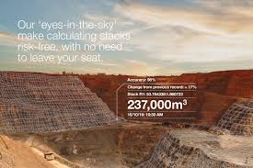
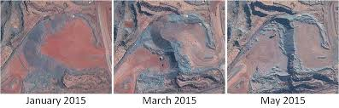
Mining & Mineral Monitoring
Airbus Defence and Space has “Stack Insight”, a uniquely accurate satellite-based change detection and volume calculation service. This service is specifically developed for mining and civil engineering applications. Stack Insight eliminates much of the cost and all the risk associated with on-site surveying.
The service can be used to remotely calculate extracted volumes, including piles and stacks of mined material. In addition it has the capability to assess changing volumes. “Stack Insight” utilises Airbus Defence and Space’s very high-resolution 50 cm imagery products from its optical Pléiades constellation, which offers high flexibility and up to daily revisit capabilities of any area around the world.
Initial studies show an error-rate of less than 2 percent, proving that “Stack Insight” is a very accurate mine and civil engineering monitoring tool. At the same time it offers the major advantage that no expensive equipment or experts are required on site. The services’ automatically derived results of structural, ground and water body changes or other surface changes are provided in a user-friendly report to match the required frequency of data collection.

Slide 7
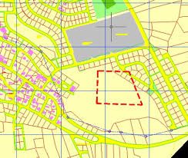
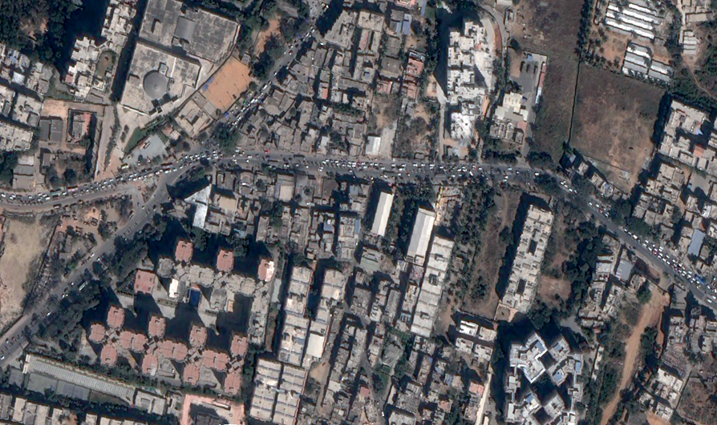
Cadastral Mapping and Urban Mapping
Cadastral map consist of:
• inventory of property parcels indicating parcel boundaries and Unique Parcel
Identifier (cadastral plans)
• register of interests (rights, restrictions, responsibilities) and interest holders (eg.
owners)
Cadastral information on a computer system to determine its:
• cadastral identifier and links
• location;
• boundary route
• land use
• components distinguished with respect to a different function or land use;
• technical fittings (mains connections)
• land purpose assigned in the local spatial development plan
• distinct attributes of a particular real estate, especially its surface and value
• Basic scale shall be in the range of 1:1000 to 1:4000
• Follow Cassini map Projection
• Datum need to be Everest Spheroid.
• Units shall be Square meters.
• Map contents need to be standardized including symbols
Spatial information
-Property parcel boundaries
-Geodetic control monuments
-Easements and right-of-ways (roads)
-Building footprints
-Administrative boundaries (general and cadastral)
Textural information
-Property identifier
-Property address
-Surveyor identifier

Slide 8
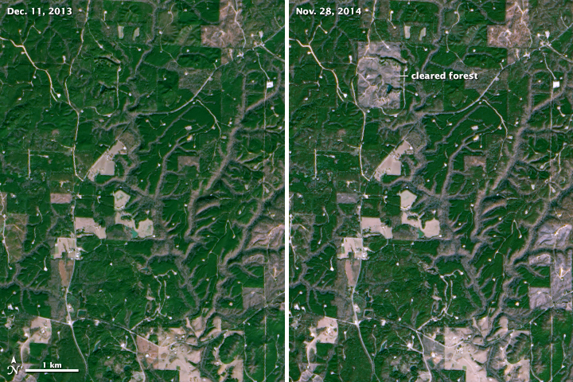
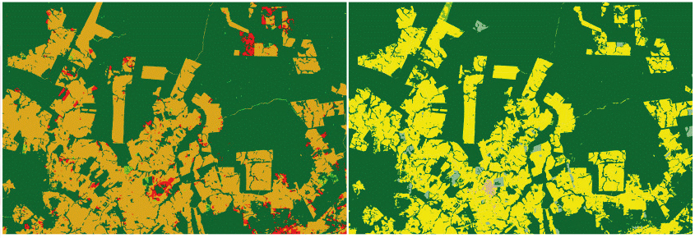
Forestry and Environment
Satellites images data is use in many applications of forestry and natural resources require accurate land cover and change analysis. Changing conditions due to urban sprawl, as well as increasing forest fragmentation, make land cover and change detection analysis an extremely important consideration for management, planning and inventory mapping. This includes ecosystem and species diversity, forest productivity, reforestation, forest health, conservation of soil, water resources, and nutrient cycling.
Satellite images and GIS maps support fire and emergency personnel for responding to emergency situations, hazardous fuels reduction, community assistance, firefighting, rehabilitation, and restoration. In order to model a forest fire, the techniques for obtaining, analyzing and displaying spatial information in a timely and cost-effective manner are needed which has proven not only to be possible, but incredibly efficient and effective.
Deforestation has been attributed to socio-demographic factors, such as population growth and the political economy of class structure, and specific exploitation activities like commercial logging, forest farming, fuel wood gathering, agriculture and pasture clearance for cattle production.

Slide 9
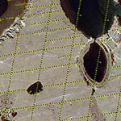
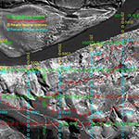
Oil and Gas
Satellite imagery incorporated with GIS can give project managers a birds-eye view of oil and gas exploration and development operations and aid in monitoring of producing fields without being present and supports assessment of facilities, pipeline corridor planning, emergencies and hazards which can reveal potential risks for sensitive areas.
Satellite image and GIS data provides insight on the selection of areas to plan 2D or 3D seismic surveys for an exploration drilling program as well as aiding in the process of environmental and operational safety hazards to minimize the HSE risks.
Development
SIC creates powerful interpretation tools for mapping and GIS projects that show the "big picture." During the planning survey, these data-filled maps are invaluable to plotting the pipeline courses, identifying potential problem areas, and determining strategy for laying pipeline through rural, mountainous, or environmentally harsh areas.
Exploration
High resolution <1m satellite map mosaics and 2m DEMs provide operators with the appropriate planning tools for the layout of 2D and 3D seismic surveys. By selecting good source offset locations, seismic data quality can improve and by selecting good access to seismic lines, environmental impact and safety risks are minimized.
Production
Satellite images are invaluable for the detection of leakage, which regular control systems may not be able to detect. Satellite Imaging Corporation acquires high resolution satellite imagery from 30 centimeters to 1 meter resolution. that can detect a spill early, saving time and money on clean up procedures.

Slide 10
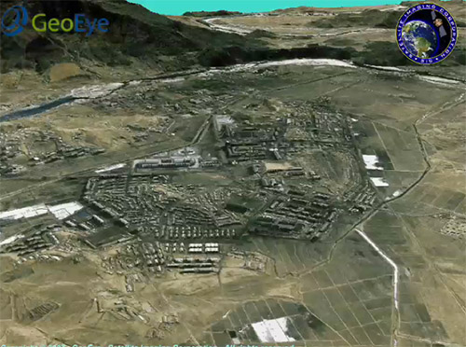
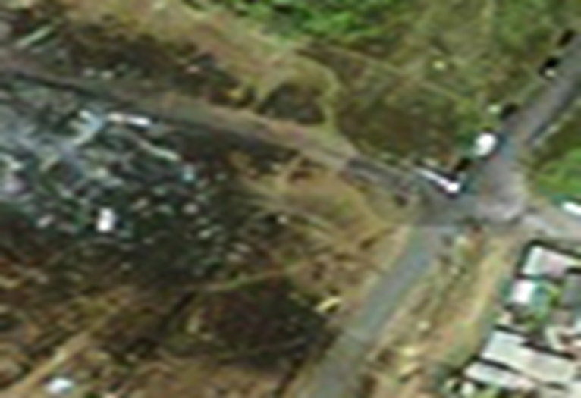
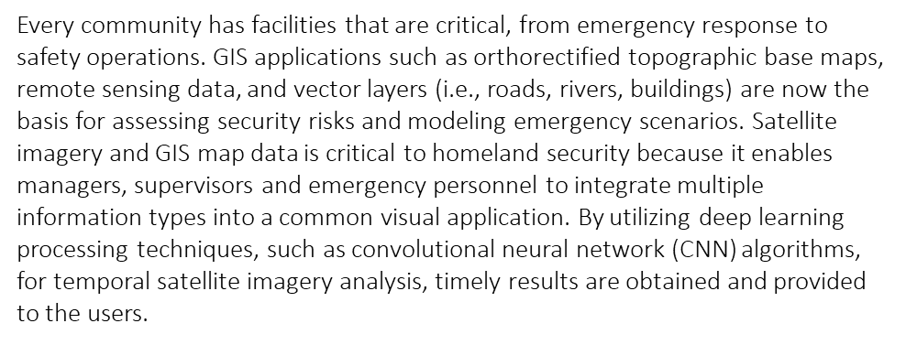
Defence and Security
geospatial products and services for government agencies and defense contractors for various applications in defense and security mapping. Micronet built a reputation on the quality and precision of the work we've delivered. From the retrieval of satellite imaging data to the final image processing, we understand the need for impeccable accuracy and image quality for your mapping and information requirements.
Satellite imagery and GIS maps maximizes security programs which can enable local governments to better assess and understand how to develop programs to save lives, protect property and enhance the future economic stability of their communities. The current threats to a country range from incidents of terrorism and information attacks on critical infrastructure to the potential use of weapons of mass destruction and the spread of infectious diseases. Each one of these threats could cause massive casualties and disruption to a country.

Slide 11



business Client

Slide 12

Customize this Template
Template Editing Instructions and Feedback

Slide 13
